Slide 1
Course Code: CSC211A Course Title: Formal Languages and Automata Theory
Lecture 30-Turing Machine-2
Course Leader:
Prakash P
prakashp.cs.et@msruas.ac.in

Slide 2
Session Objectives
At the end of this session, student will be able to
Explain the language hierarchy
Discuss Turing machine example
Understand formal definitions for Turing machines
Explain transition function
Describe Turing machine
Show the accepted language

Slide 3
Session Topics
The Language Hierarchy
Turing Machine Example
Formal Definitions for Turing Machines
Transition Function
Turing Machine
The Accepted Language

Slide 4
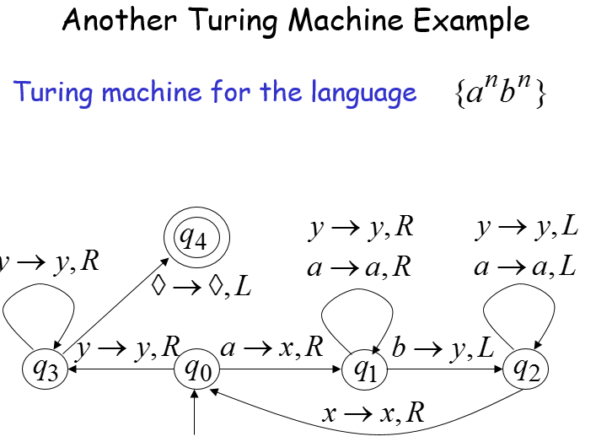
Another Turing Machine Example

Slide 5
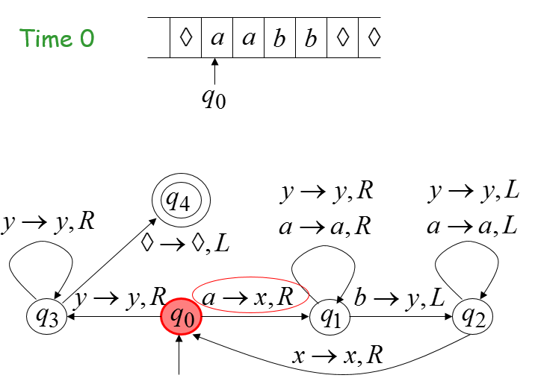
Example

Slide 6
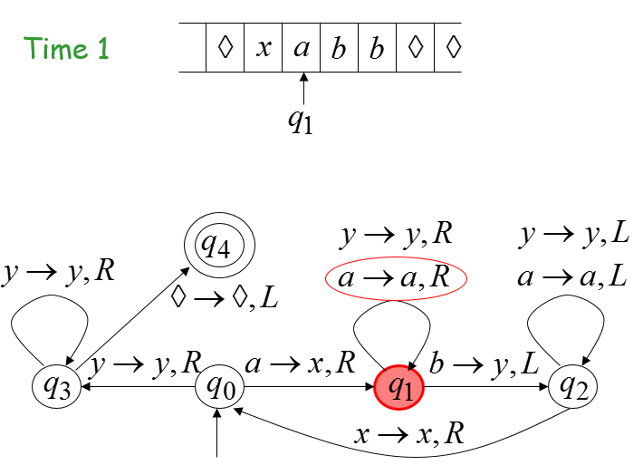
Example

Slide 7
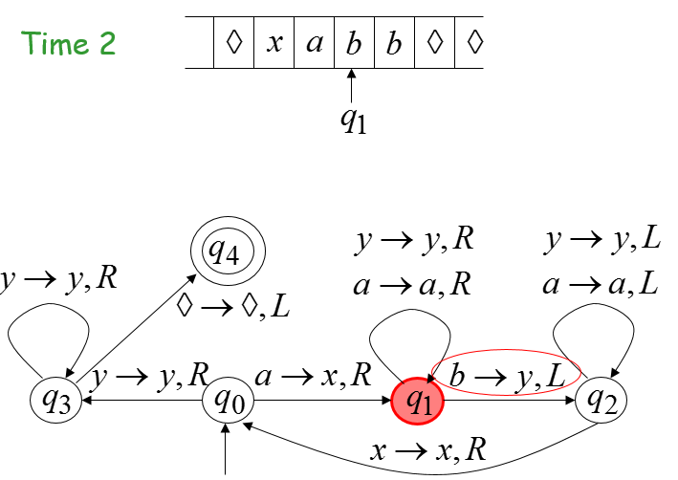
Example

Slide 8
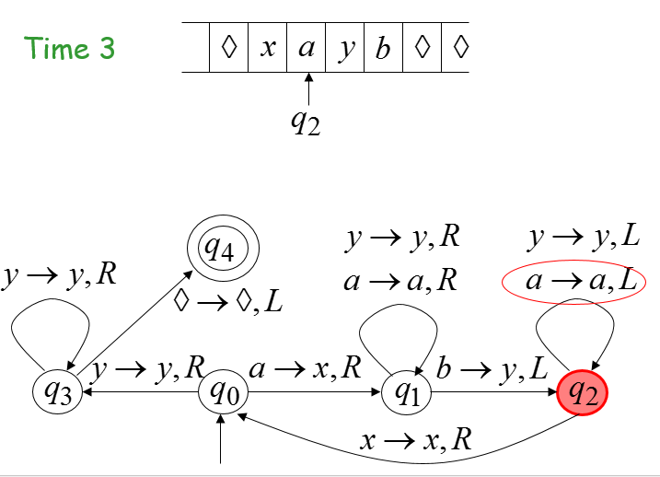
Example

Slide 9
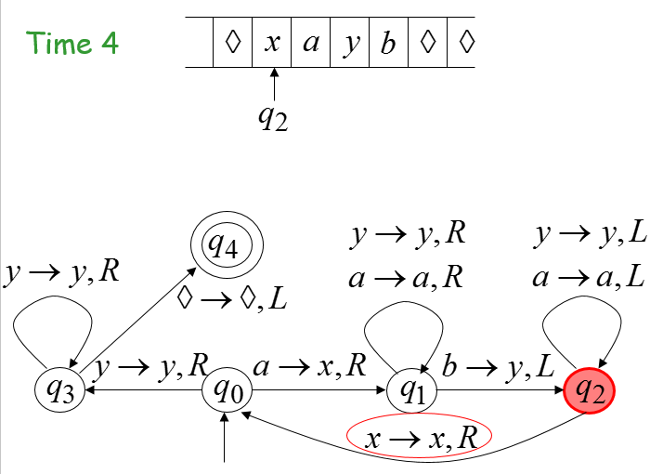
Example

Slide 10
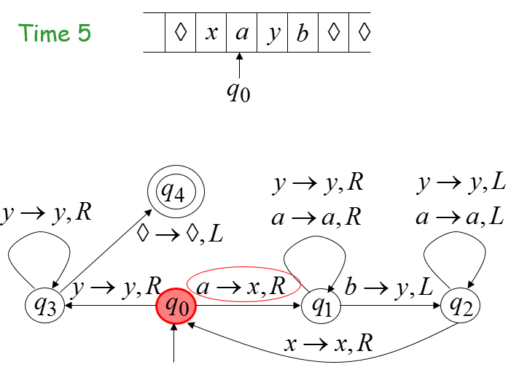
Example

Slide 11
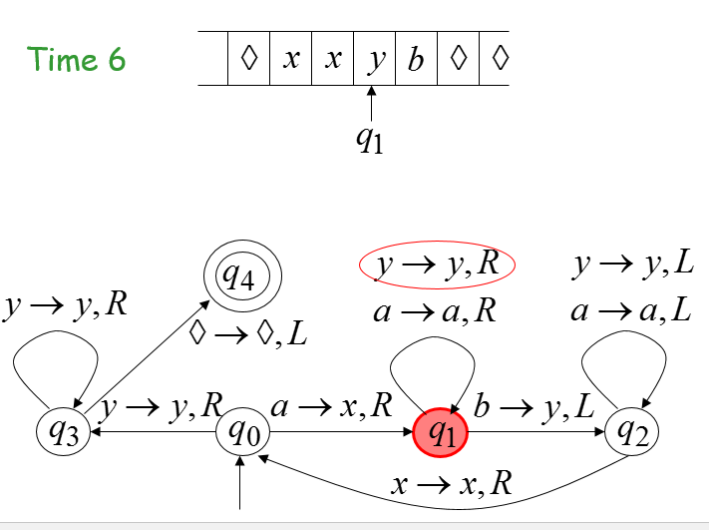
Example

Slide 12
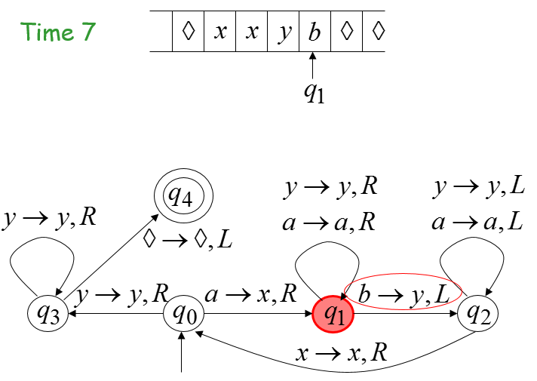
Example

Slide 13
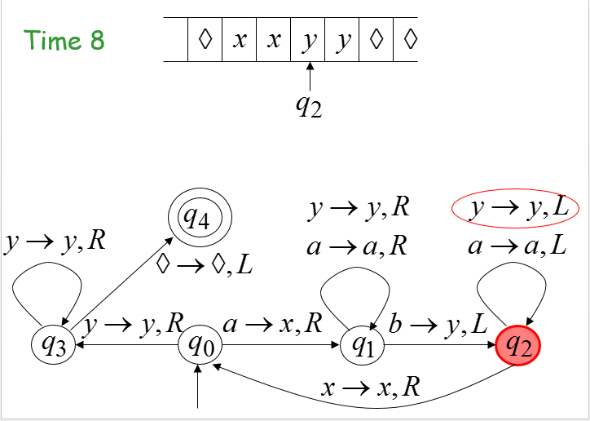
Example

Slide 14
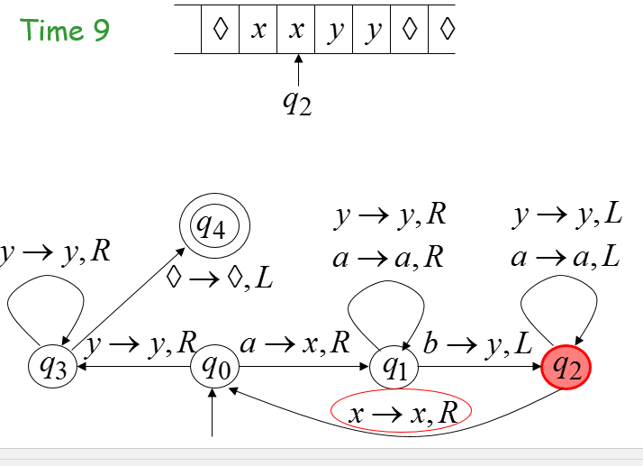
Example

Slide 15
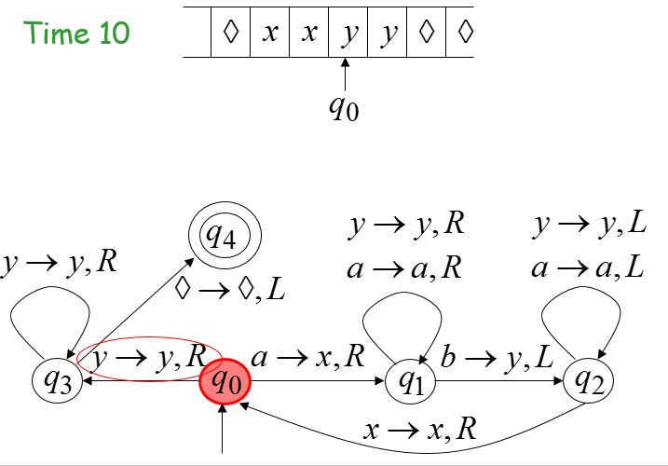
Example

Slide 16
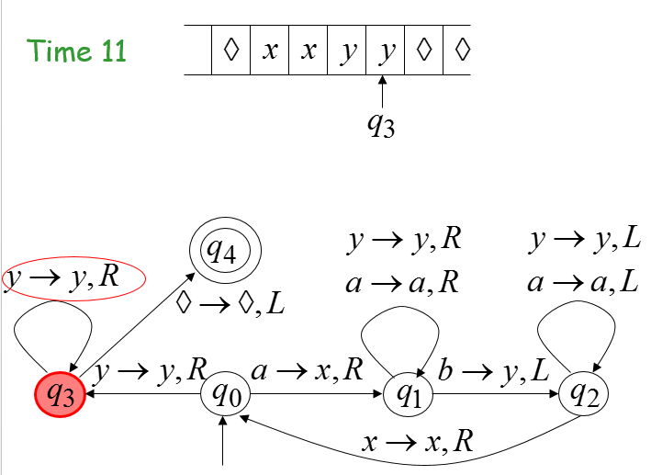
Example

Slide 17
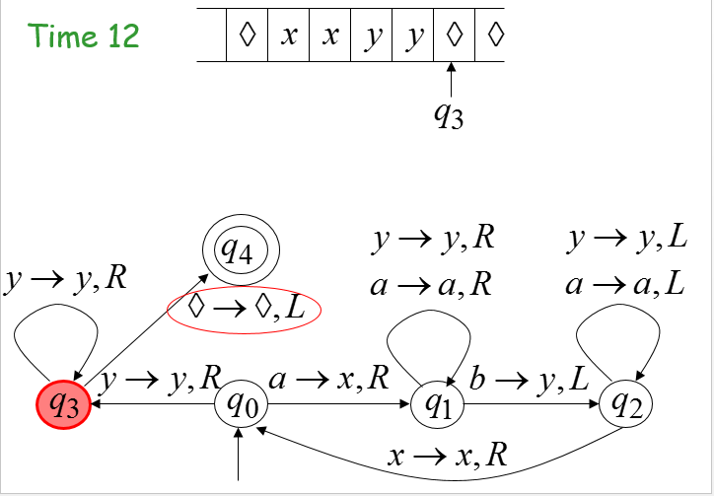
Example

Slide 18
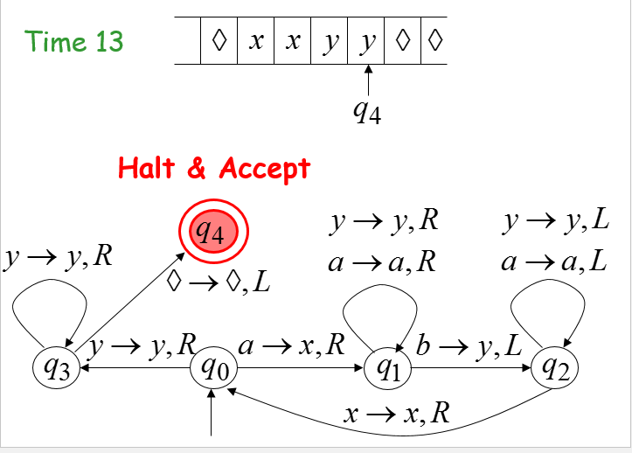
Example

Slide 19
Observation
Observation:
If we modify the machine for the language
we can easily construct a machine for the language

Slide 20
Formal Definitions for Turing Machines

Slide 21
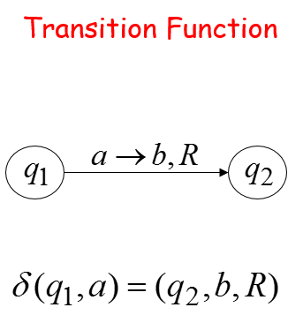
Transition Function

Slide 22
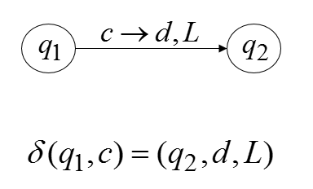
Transition Function

Slide 23
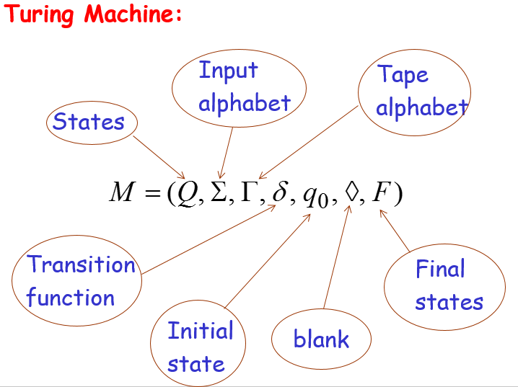
Turing Machine

Slide 24
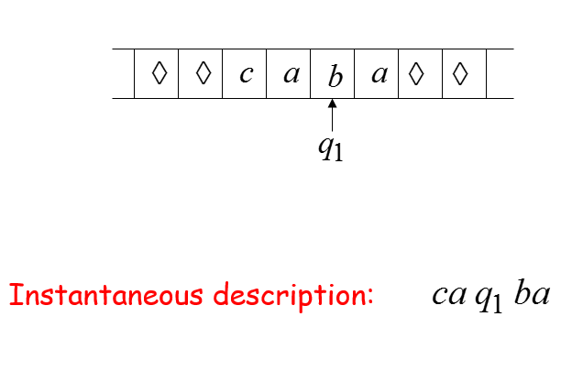
Configuration

Slide 25
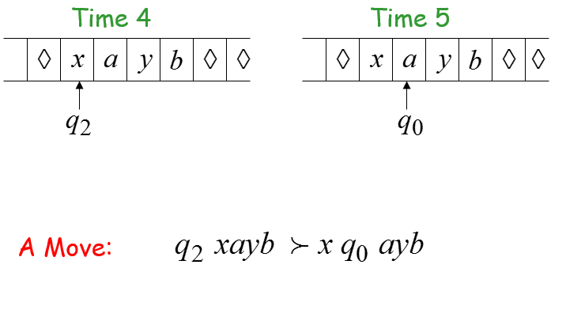
Configuration

Slide 26
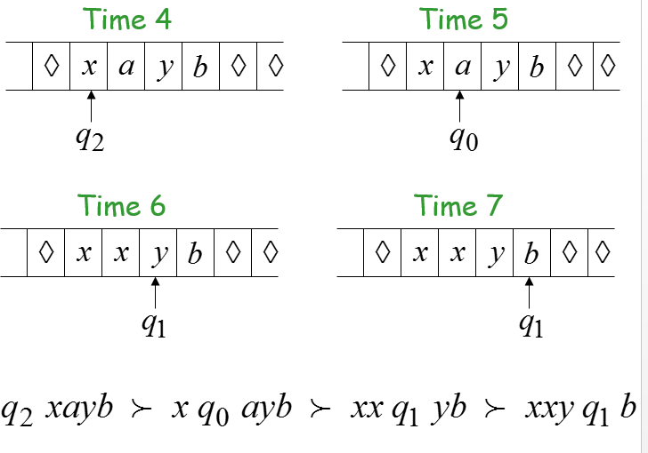
Configuration

Slide 27
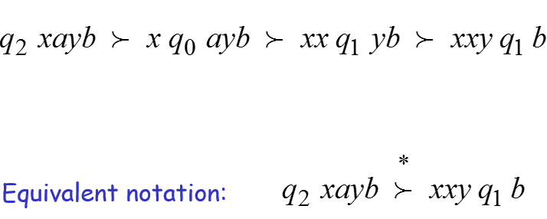
Configuration

Slide 28
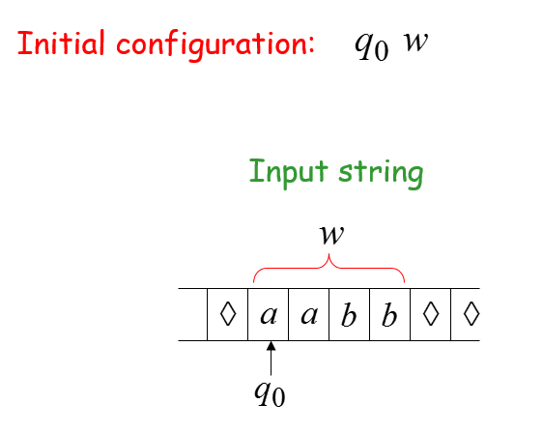
Example

Slide 29
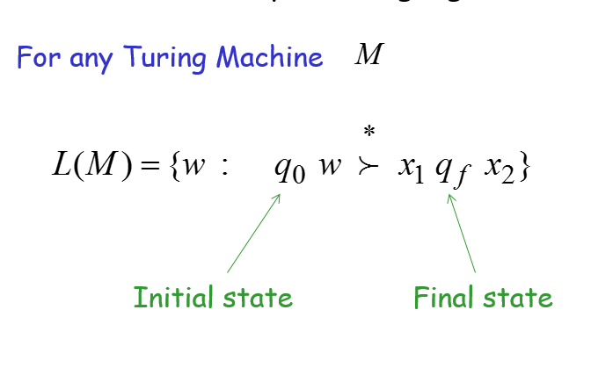
The Accepted Language

Slide 30
Standard Turing Machine
The machine we described is the standard:
Deterministic
Infinite tape in both directions
Tape is the input/output file

Slide 31
Summary
The standard machine satisfies the following properties: deterministic, infinite tape in both directions, tape is the input/output file
The formal definition of turing machine is discussed.

